Slide 1
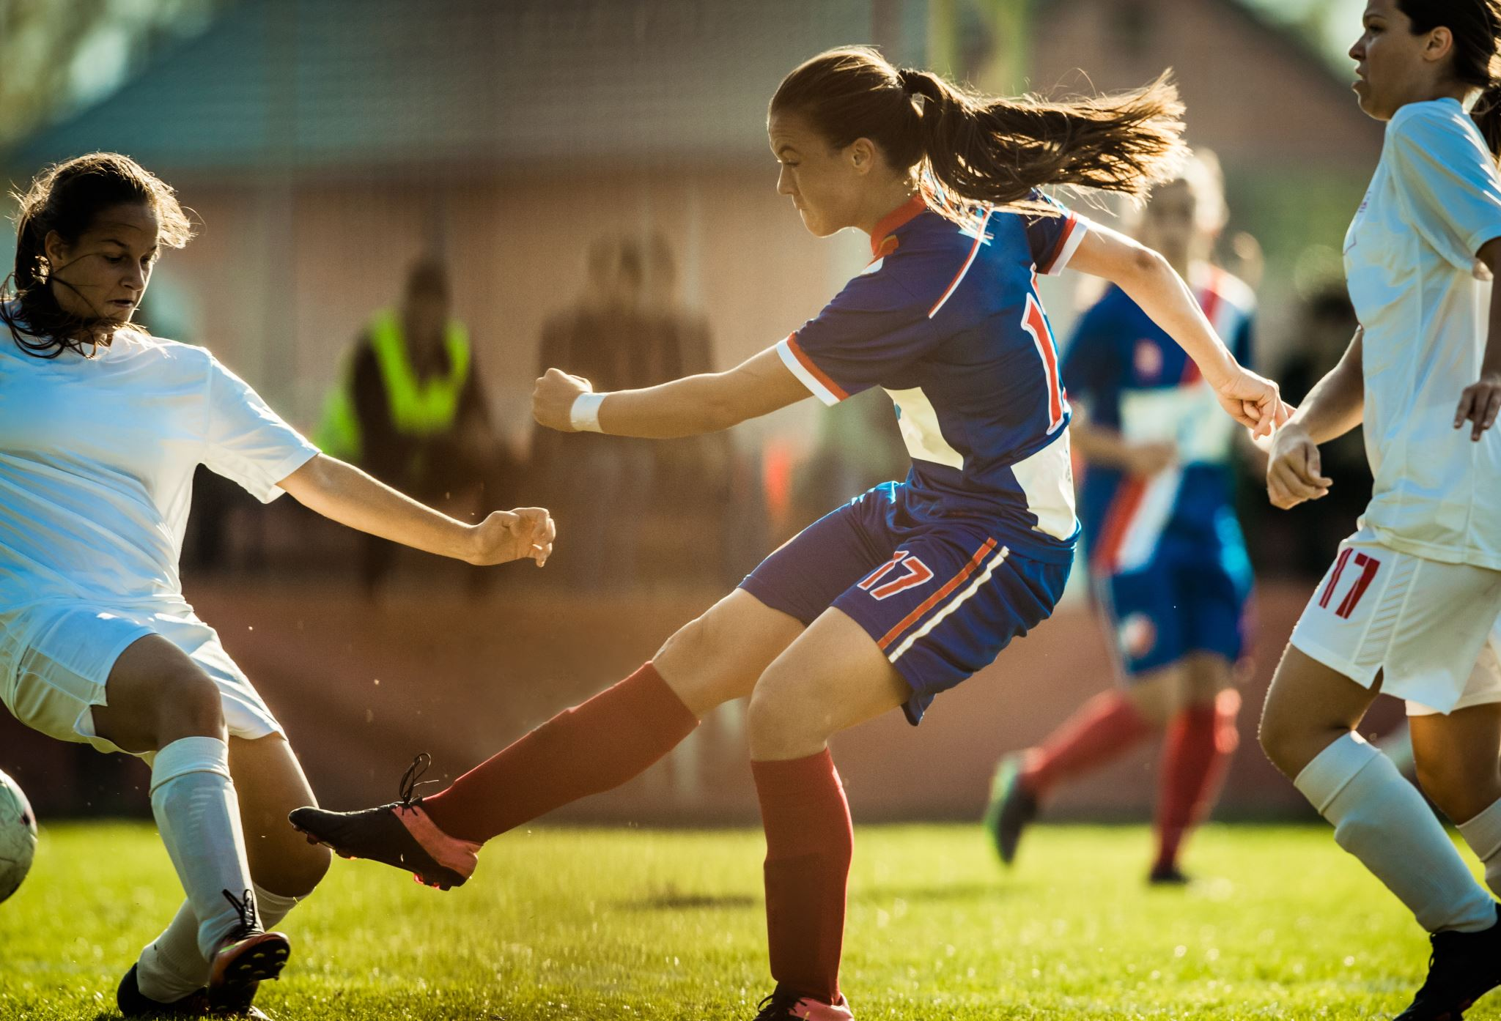
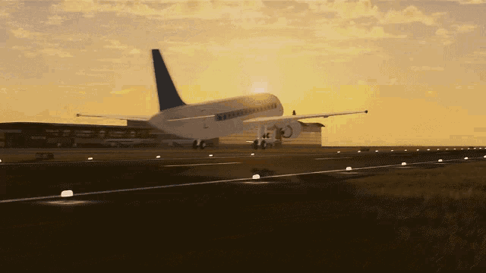
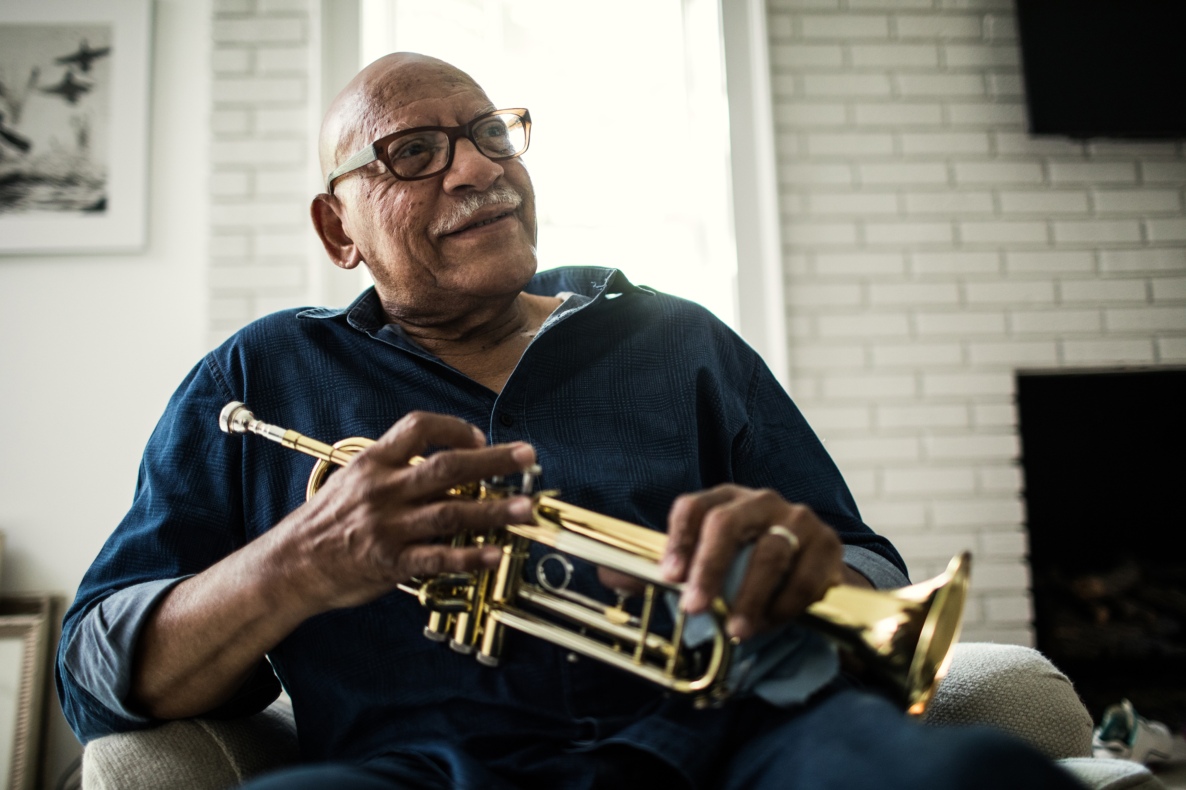

Should I Stay or
Should I Go
(Now)?
Are you wanting to travel again?
Let us know your favorite city and we will let you know what events are happening in the next 90 days along with the current Covid 19 information.
You can make a more informed decision about whether or not to travel at this time.
Where are you travelling to?
Insert name of city/county

Slide 2
Current Covid 19 Conditions in “your favorite CITY*”
*All information is current as of (put in how frequent/recently site is updated.
EVENTS THAT ARE HAPPENING IN THE NEXT 90 DAYS
LINK TO TICKETMASTER
(store information and allow user to save?)
*Regardless of the rate Covid 19 infections in any city, remember you are responsible for your own protection from the Covid 19 virus. Do your part to protect yourself:
- Get vaccinated, wear your mask and make an informed decision.

